Slide 1

DEPARTMENT OF COMPUTER ENGINEERING & TECHNOLOGY
SCHOOL OF COMPUTER SCIENCE & ENGINEERING
END-TERM SEMINAR PRESENTATION
T.Y. B.tech., Sem-VI, 2023-24

Slide 2

FINANCIAL FRAUD DETECTION using Hybrid Learning
Presented By: Harsh Khanpara, Rno:45, PRN: 1032211298
Guided By: Dr Trupti Baraskar
DCET

Slide 3
CONTENTS (Not limited to)
Title
Introduction
Motivation
Literature review
Techniques/Algorithms (description)
Block/Design Diagram, if any
Pros/Cons
Analytical or experimental work, if any
Conclusion
References
DCET

Slide 4
Title and Introduction
UNDERSTANDING GOALS OF FINANCIAL FRAUD DETECTION
Financial fraud detection using transfer learning involves leveraging pre-trained models on large datasets from related domains, such as natural language processing or image recognition, and fine-tuning them on financial transaction data to detect fraudulent activities.
Goals and benefits from such a project can be
Fraud Prevention -: Identifying anomalies in transaction patterns or behaviors, financial institutions can take proactive measures to stop fraudulent activities in real-time.
Risk Management and compliance and regulation -: These measures can be controlled and regulated as per the KYC and the predictions and advices given by our system.

Slide 5
MOTIVATION
FACTORS AND BENEFITS OF A FINANCIAL FRAUD DETECTION SYSTEM
Complexity and Scale: Financial data's vastness makes manual fraud detection challenging; transfer learning adapts pre-trained models for efficient fraud detection in this domain.
Improved Accuracy: Leveraging transfer learning from unrelated domains enhances fraud detection model accuracy by recognizing nuanced fraudulent patterns.
Real-time Prevention: Transfer learning enables deployment of real-time fraud detection models, allowing swift response to suspicious activities and minimizing losses.
Adaptability to Fraud Patterns: Transfer learning supports adaptive fraud detection by continuously updating models with evolving fraud patterns.
Compliance and Risk Management: Robust fraud detection aligns with regulatory requirements like KYC and AML, enhancing risk management and regulatory compliance.
Customer Trust: Swift fraud detection boosts customer confidence, safeguarding assets and data, and fostering strong relationships.

Slide 6
LITERATURE REVIEW
INTRODUCTION - Instance-dependent cost-sensitive learning for detecting transfer fraud
Implemented in R
Cost sensitive classification
Models prepared : Lasso-regularized logistic regression and Gradient tree boosting.
In the context of detecting transfer fraud with varying costs associated with different types of errors, a cost matrix is employed. This matrix quantifies the expenses related to both misclassifying transactions and accurately predicting them. Specifically, it takes into account the administrative expense linked to false positives (incorrectly identifying a transaction as fraudulent) and the transaction value for false negatives (fraudulent transactions that escape detection). Both false positives and true positives incur a fixed investigative cost, denoted as "cf," representing the expenses of scrutinizing the transaction and notifying the cardholder. However, the cost of a false negative is equivalent to the transaction amount, denoted as "Ai," as this mirrors the potential loss incurred by failing to identify fraudulent activity.

Slide 7
The essence of cost-sensitive decision making lies in maximizing profitability rather than solely relying on class probabilities. For instance, even if a transaction is likely legitimate, it may be rational to classify it as fraudulent to minimize potential financial losses. By utilizing a fraud detection system, financial institutions can mitigate risks, prevent monetary losses, and ultimately generate profits.
The average expected cost of a classification model on a dataset is computed as the average of the expected costs for all transactions. Notably, this metric is independent of specific threshold values, providing a comprehensive measure of the model's performance. Similarly, expected savings quantify the anticipated cost reduction achieved by employing the classification model on the dataset. These metrics provide valuable insights into the effectiveness and efficiency of the classification algorithm in minimizing financial losses associated with fraudulent transactions.
In the context of cost-sensitive decision-making, Lasso regression and Gradient boosting can incorporate cost considerations through weighted loss functions. By adjusting the weights associated with misclassification costs, Lasso regression can prioritize minimizing the overall expected loss, aligning with the objective of optimal cost-based decisions.

Slide 8
INTRODUCTION - Deep-Learning Domain Adaptation Techniques for Credit Cards Fraud Detection
Financial fraud detection using transfer learning involves leveraging deep learning models.
There are four main strategies that can be used to develop these kinds of models are
BDNN (Baseline Deep Neural Network)
NDNN (Naive Deep Neural Network)
FEDADNN (Feature Representation-based Domain Adaptation DNN)
AugDNN (Augmented Deep Neural Network)

Slide 9
BDNN -:
NDNN:
In this strategy, the same DNN architecture as BDNN is trained, but exclusively on the source domain (EC) dataset.
FEDADNN
FEDADNN focuses on feature representation to adapt knowledge from the source domain to the target domain. The augmented feature space facilitates learning across domains and imputes missing values.The DNN architecture is expanded to accommodate the increased feature dimensionality, with nh set to 165.

Slide 10
AugDNN (Augmented Deep Neural Network):
AugDNN introduces a novel technique that incorporates information from the source domain as additional features for the classifier.
It aims to capture the relatedness between the source and target domains by encoding this information in the training set.
Additional features are generated by estimating conditional distributions and marginal input distributions from the source domain.
These additional features are added to the original feature set, expanding the feature space and enhancing the classifier's ability to learn domain-related information.
The DNN architecture is modified to accommodate the augmented features on top of FEDANN.

Slide 11
Online Payment Fraud Detection Model Using Machine Learning Techniques
This research introduces RelexNET computational model.
The architecture of the ReNeXt-GRU model comprises multiple layers, each contributing to different aspects of data processing and feature extraction. The ResNeXt component enables efficient feature representation by leveraging the power of residual connections and cardinality, thereby enhancing the model's ability to capture intricate data patterns. Meanwhile, the GRU component facilitates sequential data processing, allowing the model to effectively capture temporal dependencies inherent in financial transaction data.
Furthermore, the ReNeXt-GRU model is fine-tuned with hyperparameters using the Jaya optimization algorithm, optimizing its performance and ensuring superior accuracy in classification tasks. This amalgamation of advanced architectural elements and optimization techniques culminates in a powerful artificial intelligence framework capable of addressing the complex challenges posed by financial fraud detection.
RELU Activation and Batch Normalization serves as a base line in each layer of the network.

Slide 12
The GRU architecture employs two main gates: the update gate and the reset gate. These gates enable the GRU unit to regulate the flow of information by determining how much past information to retain and how much new information to incorporate at each time step. By dynamically updating the hidden state based on the input and previous hidden state, the GRU effectively captures temporal dependencies and long-range dependencies present in the data.
Through the integration of the GRU mechanism, the ReNeXt-GRU model can effectively model the sequential nature of financial transactions, capturing patterns and trends that may indicate fraudulent activity. The GRU's ability to retain relevant information over time, coupled with the feature representation capabilities of the ResNeXt component, enhances the overall performance and accuracy of the model in detecting financial fraud.

Slide 13
TITLE | METHODS/TECHNIQUES | KEY FINDINGS
Instance-dependent Cost-Sensitive Learning for Detecting Transfer Fraud (Implemented in R) | Lasso-regularized logistic regression Gradient Tree Boosting | - Cost-sensitive classification using models like Lasso-regularized logistic regression and Gradient Tree Boosting. - Use of cost matrix to quantify expenses related to misclassifying transactions and accurately predicting them. - Emphasis on minimizing financial losses by considering transaction costs and false positives/negatives.
Deep Learning Domain Adaptation Techniques for Credit Card Fraud Detection (Deep Learning Approach) | BDNN (Baseline Deep Neural Network) NDNN (Naive Deep Neural Network FEDADNN (Feature Representation-based Domain Adaptation DNN) - AugDNN (Augmented Deep Neural Network) | - Four main strategies (BDNN, NDNN, FEDADNN, AugDNN) for domain adaptation in deep learning fraud detection models. - Utilization of deep learning models to adapt knowledge from source to target domains in fraud detection. - Introduction of feature representation to facilitate domain adaptation and improve model performance across different datasets. - Novel approach using additional features from source domain to enhance classifier's ability to learn domain-related information.

Slide 14
TITLE | METHODS/TECHNIQUES | KEY FINDINGS
Online Payment Fraud Detection Model Using Machine Learning Techniques | ReNeXt-GRU computational model RELU Activation and Batch Normalization in each layer | - Utilization of ResNeXt for feature representation and GRU for sequential data processing in fraud detection. - Optimization using Jaya optimization algorithm to fine-tune model hyperparameters and improve classification accuracy. - Effective modeling of sequential financial transaction data, capturing patterns indicative of fraudulent activity through advanced architectural elements and optimization techniques.
Unsupervised Anomaly Detection for Credit Card Fraud | Isolation Forest | - Application of Isolation Forest algorithm for unsupervised anomaly detection in credit card transactions.

Slide 15
ADVANCED TECHNIQUES USED IN FINANCIAL FRAUD PREVENTION AND DETECTION
BERT (Bidirectional Encoder Representations from Transformers):
While BERT is well-known for natural language processing tasks, it has also been used for financial document classification and understanding financial news sentiment. You can pre-train BERT on financial documents or news articles related to transactions and fraud.
BERT for Finance (FinBERT):
Researchers have created domain-specific BERT models for finance. FinBERT, for example, is pre-trained on financial texts and could be fine-tuned for tasks related to financial transactions or fraud detection.
DeepWalk and Node2Vec:
These are graph embedding methods that learn representations for nodes in a graph. Since financial transactions can be represented as graphs (nodes representing accounts, edges representing transactions), these methods can be useful for capturing patterns in transactional data.
ANAMOLY DETECTION ALGORITHMS LIKE ISOLATION FORESTS AND BERT-AD(Anamoly Detection Algorithms) also can be incorporated.

Slide 16
BERT and FINBERT
BERT can also be applied to analyze sentiment in financial news articles. By pre-training BERT on a corpus of financial news articles, it learns to understand the sentiment conveyed by words and phrases commonly found in this domain. For example, it can identify positive or negative sentiment related to company performance, market trends, or economic indicators. This can be useful for investors or analysts looking to gauge market sentiment or make informed decisions.
FinBERT is a domain-specific variant of BERT that has been pre-trained on financial texts, such as annual reports, financial news articles, or regulatory filings. This pre-training allows FinBERT to better understand the language and context specific to the finance domain, including terminology, jargon, and financial concepts. FinBERT can then be fine-tuned for various finance-related tasks, such as fraud detection, sentiment analysis, or financial document classification. For example, it might be fine-tuned to detect fraudulent transactions based on patterns in financial statements or banking communications.

Slide 17
ISOLATION FORESTS IN FINANCIAL FRAUD DETECTION
Isolation Forests work by randomly selecting a feature and then randomly selecting a split value between the maximum and minimum values of that feature to isolate anomalies.
The process of splitting is repeated recursively until anomalies are isolated into individual trees, while normal data points tend to be grouped together in larger subtrees.
Anomalies are identified as data points that require fewer splits to isolate, making them "isolated" from the majority of the data.
For example, consider a dataset of credit card transactions. Most transactions may follow typical spending patterns for a given user, such as frequent small purchases and occasional larger ones. Anomalies might represent transactions that deviate significantly from these patterns, such as unusually large purchases, transactions in different geographical locations, or transactions at odd hours.

Slide 18
Architecture Overview:
1. Data Ingestion and Preprocessing : Financial transaction data from various sources (e.g., transaction logs, account information) is collected and preprocessed. Textual data (e.g., financial news, documents) related to transactions is also gathered.
2. Textual Data Processing with FinBERT:
Task: Analyzing financial text for sentiment, topic extraction, or contextual understanding related to transactions and entities.
Method:
Pre-trained FinBERT model processes textual data to extract features and representations specific to financial language and concepts.
Output embeddings are obtained for further analysis.

Slide 19
Architecture Overview:
3. Graph Representation with DeepWalk/Node2Vec:
Task: Representing financial transactions and entities as a graph to capture relational patterns.
Method:
Construct a graph where nodes represent accounts/entities and edges represent transactions between them.
Apply graph embedding techniques (e.g., DeepWalk, Node2Vec) to learn vector representations for nodes capturing local and global graph structure.
4. Anomaly Detection Using Isolation Forests and BERT-AD:
Task: Identifying unusual or fraudulent patterns in financial data.
Method:
Isolation Forests: Implement unsupervised learning to isolate outliers in the feature space, flagging potentially fraudulent transactions or account behaviors.
BERT-AD (BERT-based Anomaly Detection): Fine-tune BERT for anomaly detection tasks, leveraging pre-trained language models to detect abnormalities in textual descriptions or patterns.

Slide 20
5. Integration and Ensemble:
Combine the outputs from different modules (FinBERT, Graph Embeddings, Anomaly Detection) into a unified representation or decision-making system.
Use ensemble learning techniques or weighted voting to combine predictions and enhance overall fraud detection accuracy.

Slide 21
FINANCIAL DATA (TRANSACTION AND KYC,ACCOUNT INFO)
TEXT PREPROCESSING
FINBERT FOR TEXT REPRESENTATION
ENSEMBLE LEARNING
GRAPH CONSTRUCTION
GRAPH EMBEDDINGS (NODE2VEC AND DEEP WALK)
FRAUD DETECTION AND PREVENTION
ANOMOLY DETECTION

Slide 22
PROS AND CONS OF SUCH A SYSTEM DESIGN
PRO’S
Comprehensive Feature Representation (FINBERT + GRAPH)
Domain-specific Learning (LLM’S)
Graphical intuitive insights
Anomaly Detection Capabilities
Ensemble Learning for Enhanced Accuracy
CON’S
Complexity and Resource Intensiveness
Integration Challenges (Handing data flow)
Interpretability is not present as output is produced through ensemble approach.
Model Maintenance and Adaptability

Slide 23
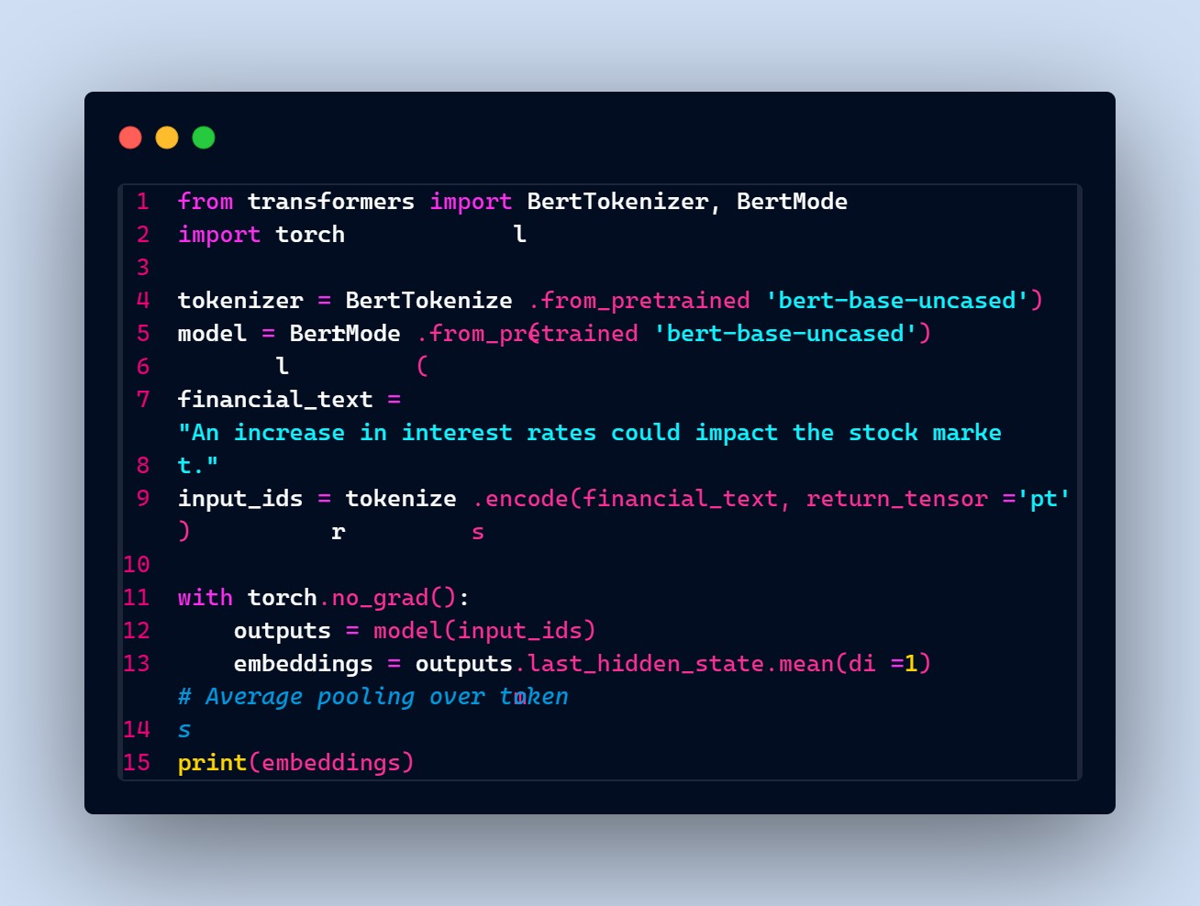
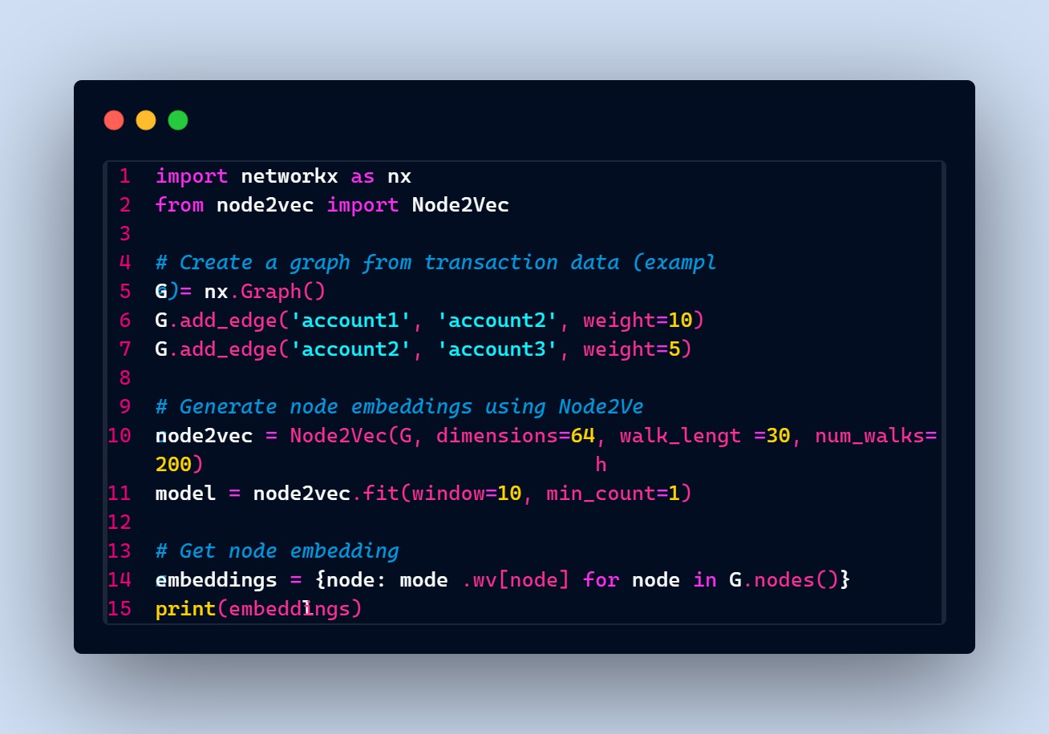
PSEUDO IMPLEMENTATION
PHASE 1 : PREPROCESSING AND BERT EMBEDDING
PHASE 2 : CONSTRUCTING GRAPH

Slide 24
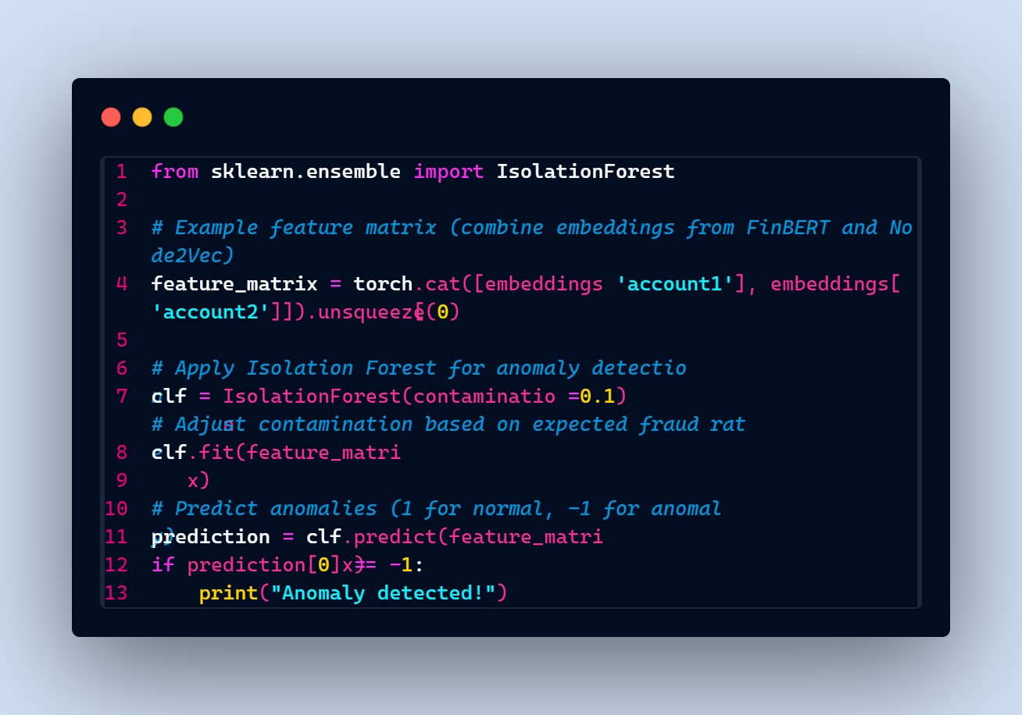
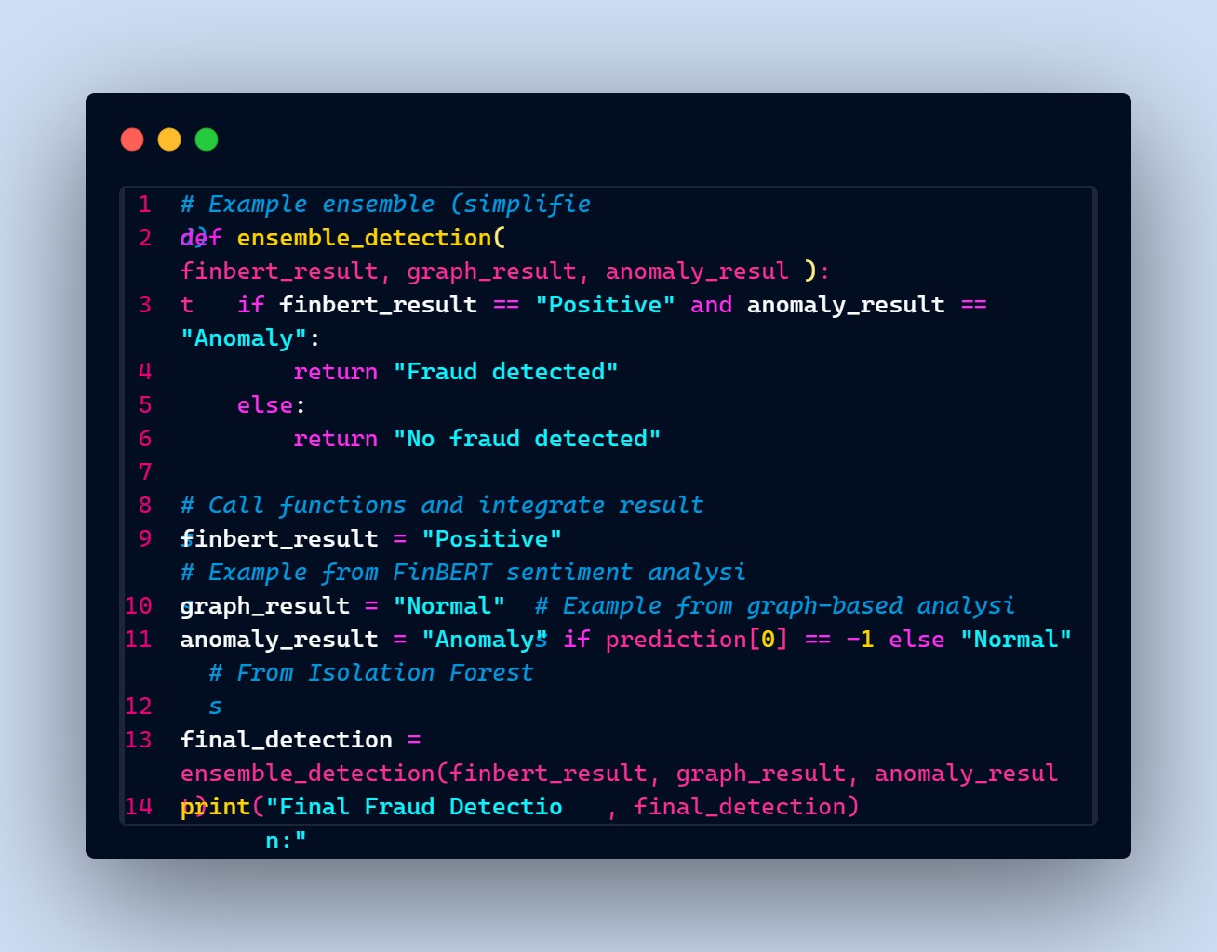
PSEUDO IMPLEMENTATION
PHASE 3: ANOMOLY DETECTION
PHASE 4: ENSEMBLING RESULTS

Slide 25
REFERENCES
1.Sebastiaan Höppner, Bart Baesens, Wouter Verbeke, Tim Verdonck, Instance-dependent cost-sensitive learning for detecting transfer fraud,European Journal of Operational Research,Volume 297, Issue,2022,Pages 291-300,ISSN 0377-2217
2.Lebichot, B., Le Borgne, YA., He-Guelton, L., Oblé, F., Bontempi, G. (2020). Deep-Learning Domain Adaptation Techniques for Credit Cards Fraud Detection. In: Oneto, L., Navarin, N., Sperduti, A., Anguita, D. (eds) Recent Advances in Big Data and Deep Learning. INNSBDDL 2019. Proceedings of the International Neural Networks Society, vol 1. Springer, Cham. https://doi.org/10.1007/978-3-030-16841-4_8
3.@ARTICLE{10341223,author={Almazroi, Abdulwahab Ali and Ayub, Nasir}, journal={IEEE Access}, title={Online Payment Fraud Detection Model Using Machine Learning Techniques}, year={2023}, volume={11}
4.D. Araci, "FinBERT: Financial Sentiment Analysis with Pre-trained Language Models," arXiv:1908.10063, 2019.
5.Yang, X.; Zhang, C.; Sun, Y.; Pang, K.; Jing, L.; Wa, S.; Lv, C. FinChain-BERT: A High-Accuracy Automatic Fraud Detection Model Based on NLP Methods for Financial Scenarios. Information 2023, 14, 499. https://doi.org/10.3390/info14090499
6.John, Hyder, and Sameena Naaz. "Credit card fraud detection using local outlier factor and isolation forest." Int. J. Comput. Sci. Eng 7.4 (2019): 1060-1064.

Slide 26
CONCLUSION
In the realm of financial data, complexity and hidden patterns necessitate the development of sophisticated approaches for fraud detection, given the substantial losses associated with fraudulent activities. Leveraging advanced techniques like FinBERT, graph embeddings, and anomaly detection algorithms is essential to uncover nuanced relationships and anomalies within transactional data. Addressing challenges and anomalies in financial data requires continuous improvement, emphasizing data quality, interpretability, and scalability. Looking ahead, cross-domain application and collaboration will drive innovation, enhancing the resilience of financial systems against evolving threats.

Slide 27
THANK YOU!!!
DCET

